Slide 1
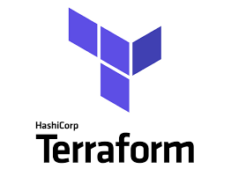

Terraform
B
Y
K
U
M
A
R
B
Y
K
U
M
A
R

Slide 2
Terraform pros & cons
Pros | Cons
Declarative | Dose not support rollback after failure
Inbuilt state management | Does not support DRY inbuild future
Maintains the version history of the infrastructure | Declarative languages limitations
Use a client-only architecture
Immutable
Open Source
Orchestration
Interpolation-only expressions are deprecated

